Slide 1
EECS 498 System Design of a Search Engine
Winter 2026
Lecture 24: Intellectual Property and Marketing
Nicole Hamilton
https://web.eecs.umich.edu/~nham/
nham@umich.edu

Slide 2
agenda
details
intellectual property
marketing

Slide 3
agenda
details
intellectual property
marketing

Slide 4
details
I have posted guidance on your presentations to Canvas in the Files > Assignments folder.
Tell me when you’d like to present at Edstem #142.
W25 final exam solutions posted to Canvas in Files > Exams > Final folder.
I am working on guidance for your final reports.
Course evals have opened and stay open until Wed Apr 22.
Peer eval forms posted to Canvas, due Tue Apr 21.

Slide 5
remaining schedule
Today: Dealer’s choice: Intellectual property and marketing
Tue April 14: Review for the final
Thu April 17, Fri April 18, Tue April 21: Presentations
Tues Apr 21: Peer evals, final reports and project archive due
Wed April 22 through Wed April 29: Team debriefs
Wed April 29 4:00pm: Optional final exam, Dow 1013 and 1206.

Slide 6
agenda
details
intellectual property
marketing

Slide 7
intellectual property
Defined as valuable intangible property owned by persons or companies.
Intangible means you can’t point to it. It’s distinct from physical property like land, machines, or jewelry.

Slide 8
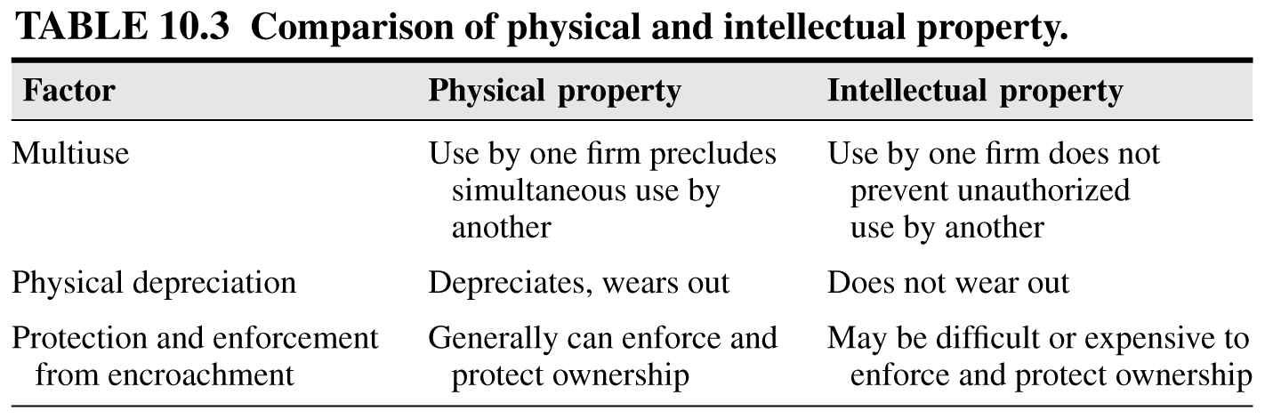

Slide 9
key concepts
Trade secrets
Patents
Trademarks
Copyrights

Slide 10
key concepts
Trade secrets
Patents
Trademarks
Copyrights
A trade secret is a confidential intellectual asset that is maintained as secret by the owner and provides a competitive advantage.
Lifetime is potentially indefinite. Formula for Coca-Cola is over a 100 years old.

Slide 11
key concepts
Trade secrets
Patents
Trademarks
Copyrights
Risks:
Employees may learn the information and then leave, possibly to start a competitor.
The information could also be stolen or independently invented.
Responses:
Non-disclosure and employment agreements.

Slide 12
key concepts
Trade secrets
Patents
Trademarks
Copyrights
A patent grants the inventor the right to exclude others from making, using or selling their invention for a limited time in return for public disclosure.
In the US, patent lifetime is 20 years from date of filing.

Slide 13
key concepts
Trade secrets
Patents
Trademarks
Copyrights
A patent may protect:
New and useful machines
Manufactured products
Industrial processes
New chemical compounds
Foods
Medicines

Slide 14
key concepts
Trade secrets
Patents
Trademarks
Copyrights
Types of patents:
Utility patents: new, useful, non-obvious processes, machines and manufactured products.
Design patents: new, original, ornamental and non-obvious manufactured items, e.g., Steve Jobs’s staircase, Macintosh and iPod designs.
Plant patents: New varieties of plants that have been asexually reproduced.
Business method patent: A type of utility patent covering a process or method, e.g., Amazon’s “one-click” ordering process.

Slide 15
key concepts
Trade secrets
Patents
Trademarks
Copyrights
One of the main requirements of a utility patent is that the invention must be non-obvious.
The definition is that a "person having ordinary skill in the art" would not know how to solve the problem in the manner being disclosed without being told.

Slide 16
key concepts
Trade secrets
Patents
Trademarks
Copyrights
A design patent protects an ornamental design of a functional item.
Ornamental designs of jewelry, furniture, beverage containers and computer icons are examples of things that may be protected by design patents.

Slide 17
key concepts
Trade secrets
Patents
Trademarks
Copyrights
A patent application costs about $20,000 to $50,000 in legal fees. Not all applications ever result in an issued patent.
Litigation to enforce a patent even more expensive. Competitors may invent around a patent anyway.

Slide 18
key concepts
Trade secrets
Patents
Trademarks
Copyrights
A trademark is any distinctive word, name, symbol, slogan, shape, sound or logo that identifies the source of a product or service.
Renewable indefinitely as long as commercial use is proven.
May lose exclusive right to a trademark if it becomes generic, e.g., aspirin, thermos, cellophane.

Slide 19
key concepts
Trade secrets
Patents
Trademarks
Copyrights
A copyright is the right of an author to prevent others from printing, copying or publishing his or her original works.
Life of a copyright = life of the author + 70 years
A copyright exists from the moment of creation, even if there is no copyright notice.
To sue for infringement, must register your copyright with the US Copyright Office, but process is simple and cheap.

Slide 20
patents are property
They can be bought, sold, licensed, assigned or mortgaged.
They may passed to heirs of a deceased inventor.
If a patented invention is used without authorization, the patent holder may sue for money damages.

Slide 21
Work for hire
Only the author or those deriving rights from the author can rightfully claim copyright.
Exception: “Works made for hire.”
If a work is made for hire, an employer is considered the author even if an employee actually created the work. The employer can be a firm, an organization, or an individual.

Slide 22
Definition of a work for hire
Section 101 of the Copyright Act (title 17 of the U.S. Code.
Two parts:
A work prepared by an employee within the scope of his or her employment .
A work specially ordered or commissioned which the parties agree in a signed written document is a work made for hire and which is one of the following.
  A contribution to a collective work
  A part of a motion picture or other audiovisual work,
  A translation,
  A supplementary work,
  A compilation,
  An instructional text,
  A test,
  Answer material for a test, or
  An atlas

Slide 23
Examples of works made for hire created in an employment relationship
A software program created by a staff programmer within the scope of his or her duties at a software firm.
A newspaper article written by a staff journalist for publication in the newspaper that employs the journalist (who is not a freelance writer).
A musical arrangement written for a music company by a salaried arranger on the company’s staff .
A sound recording created by salaried staff engineers of a record company.

Slide 24
First sale doctrine
The physical ownership of an item such as a book, painting, manuscript or CD is not the same as owning the copyright to the work embodied in that item.
Ownership of a physical copy of a copyright-protected work permits lending, reselling, disposing, etc., of the item.
It does not permit reproducing the material, publicly displaying or performing it, or engaging in any of the acts reserved for the copyright holder.

Slide 25
Licensing
A contractual method of exploiting intellectual property by transferring rights to use without a transfer of ownership.
Rights to use are defined in a contract and usually require payment of a royalty or fee.

Slide 26
agenda
details
intellectual property
marketing

Slide 27
key concepts
The definition of a market.
The value proposition.
The product, substitutes and complementors.
Differentiation.
Barriers to entry and exit.
Buyers and heavy users.

Slide 28
key concepts
The definition of a market.
The value proposition.
The product, substitutes and complementors.
Differentiation.
Barriers to entry and exit.
Buyers and heavy users.

Slide 29
the definition of a market
Marketers require that to be an actual market that a business might operate in, it must be
identifiable,
substantial,
differentiable,
accessible,
stable, and
actionable.

Slide 30
the definition of a market
Marketers require that to be an actual market that a business might operate in, it must be
identifiable,
substantial,
differentiable,
accessible,
stable, and
actionable.
Identifiable means the buyers can be identified by some characteristics they share in common.
For consumers, occupation, age, where they live, hobbies.
For businesses, their SIC (Standard Industry Classification) code, location, areas served.

Slide 31
the definition of a market
Marketers require that to be an actual market that a business might operate in, it must be
identifiable,
substantial,
differentiable,
accessible,
stable, and
actionable.
Substantial means the market has to be big enough to support a business.
It can’t be 3 people who want hammers with builtin WiFi.

Slide 32
the definition of a market
Marketers require that to be an actual market that a business might operate in, it must be
identifiable,
substantial,
differentiable,
accessible,
stable, and
actionable.
Differentiable means that potential customers must share characteristics that differentiate them from others who are unlikely to buy.

Slide 33
the definition of a market
Marketers require that to be an actual market that a business might operate in, it must be
identifiable,
substantial,
differentiable,
accessible,
stable, and
actionable.
Accessible means it’s possible to reach these potential customers with your message and provide the product and service and you’re selling at an affordable cost.

Slide 34
the definition of a market
Marketers require that to be an actual market that a business might operate in, it must be
identifiable,
substantial,
differentiable,
accessible,
stable, and
actionable.
Stable means you can make plans about the future. There’s a rule of law and it will be there tomorrow.

Slide 35
the definition of a market
Marketers require that to be an actual market that a business might operate in, it must be
identifiable,
substantial,
differentiable,
accessible,
stable, and
actionable.
Actionable means it’s possible create and act on a plan to address the market and make an attractive profit.

Slide 36
key concepts
The definition of a market.
The value proposition.
The product, substitutes and complementors.
Differentiation.
Barriers to entry and exit.
Buyers and heavy users.

Slide 37
key concepts
The definition of a market.
The value proposition.
The product, substitutes and complementors.
Differentiation.
Barriers to entry and exit.
Buyers and heavy users.

Slide 38
The value proposition
Value is the worth, importance, or usefulness to the customer. It is the value a business proposes to deliver.
To be successful, a business must create value, selling goods or services that are more valuable than whatever it cost to create them.

Slide 39
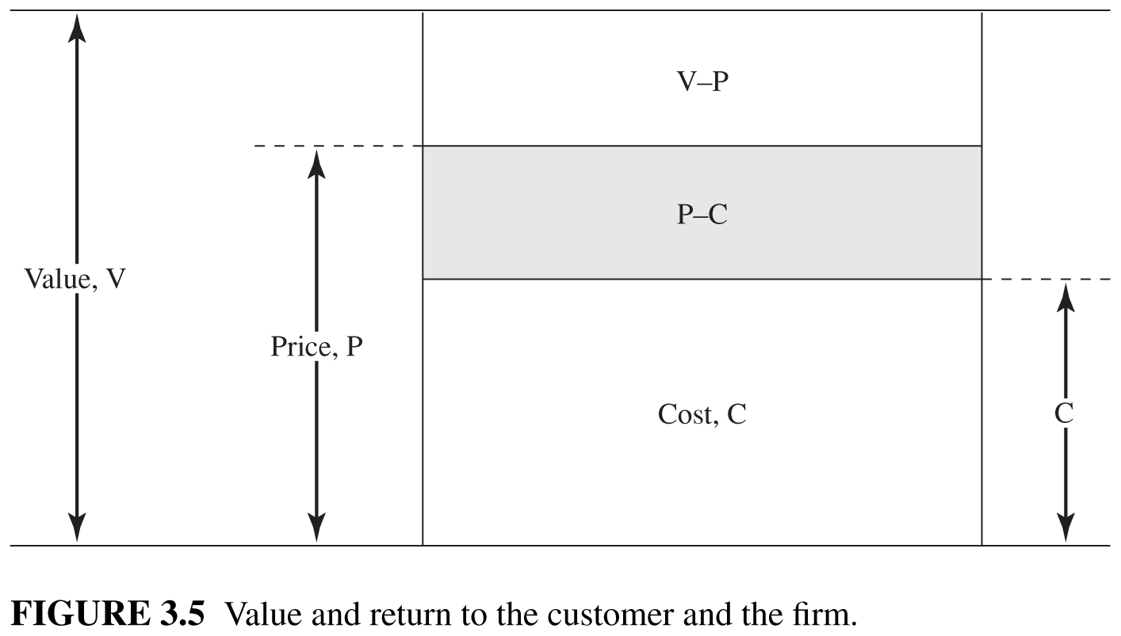
Source: Technology Ventures, 4th ed, p 58

Slide 40
Value propositions
Most value propositions offer some combination of these values to the customer:
Product
Price
Access
Service
Experience

Slide 41
Primary and secondary values
A primary value typically dominates the value proposition.
A secondary value typically differentiates the offering.
The remaining values must meet industry norms.

Slide 42
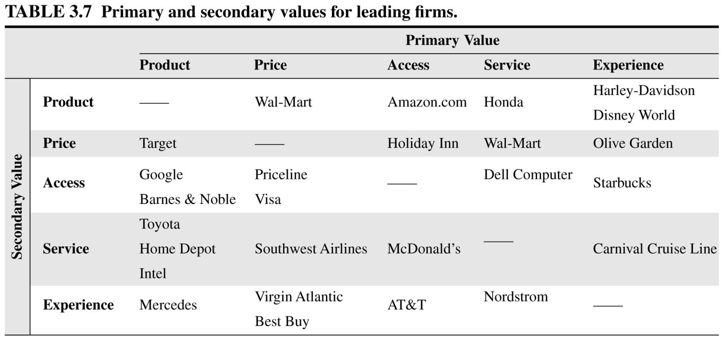
Source: Technology Ventures, 4th ed, p 57

Slide 43
Wal-Mart is the leader in low prices and huge selection.
Source: Technology Ventures, 4th ed, p 57

Slide 44
price, selection, and convenience continue to be at the core of Amazon.com's value proposition
Source: Technology Ventures, 4th ed, p 57

Slide 45
Our focus on retail sales to individual buyers has a direct correlation to the high resale value of Honda products, which is a key factor in the value proposition for our customers
Source: Technology Ventures, 4th ed, p 57

Slide 46
more power, greater efficiency and unmatched safety, backed with an improved value proposition. Not only is the new S-Class the most intelligent car on the road …
Source: Technology Ventures, 4th ed, p 57

Slide 47
the Dell value proposition of aggressively priced systems custom-built for each customer.
Source: Technology Ventures, 4th ed, p 57

Slide 48
McDonald's is famous for its value proposition: food of a constant quality that is served quickly and consistently across the globe.
Source: Technology Ventures, 4th ed, p 57

Slide 49
Carnival built an unmatched value proposition on the promise of fun.
Source: Technology Ventures, 4th ed, p 57

Slide 50
key concepts
The definition of a market.
The value proposition.
The product, substitutes and complementors.
Differentiation.
Barriers to entry and exit.
Buyers and heavy users.

Slide 51
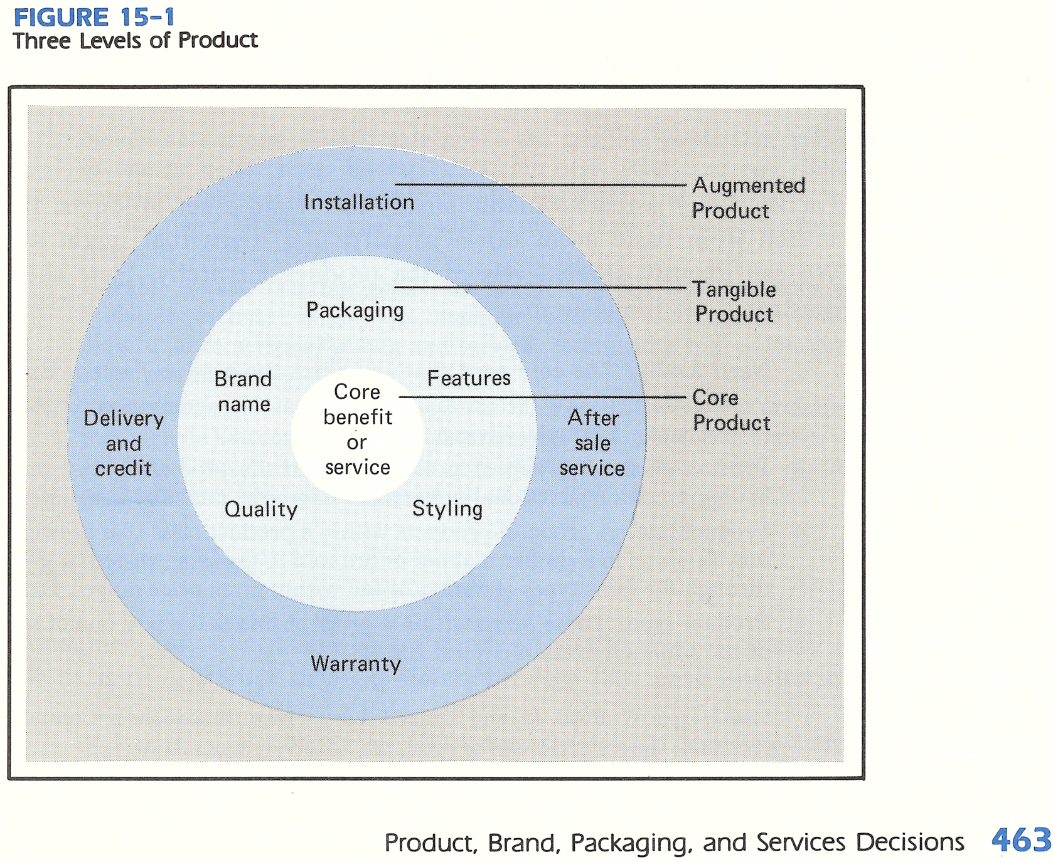
Source: Philip Kotler, Marketing Management, 5th edition, p. 463.

Slide 52
Substitution is the process by which one product or service supplants another in performing a particular function or functions for a buyer.
Source: Porter, Competitive Advantage, p. 273.

Slide 53
Examples of substitution
Apple pie instead of ice cream for dessert.
High fructose corn syrup instead of sugar.
A train instead of a truck to ship freight.
A bicycle or bus instead of a car to commute.
Skype instead of a plane ticket to attend a meeting in San Francisco.
Using less. E.g., thinner aluminum cans.
Used, recycled or reconditioned products.
Backward integration. Your buyer decides to do it himself.
Downstream substitution. E.g., electric cars don’t need transmissions.

Slide 54
Complementors
Complementors are companies that sell complements to a firm’s products.
A complement is a product that improves or perfects another product.
Examples: Video games for the Xbox, gas stations for automobiles, installation services for furnaces.

Slide 55
key concepts
The definition of a market.
The value proposition.
The product, substitutes and complementors.
Differentiation.
Barriers to entry and exit.
Buyers and heavy users.

Slide 56
Product differentiation means brand identification and customer loyalty stemming from past advertising, customer service, product differences or simply being first.
But it’s also possible to differentiate in other ways.

Slide 57
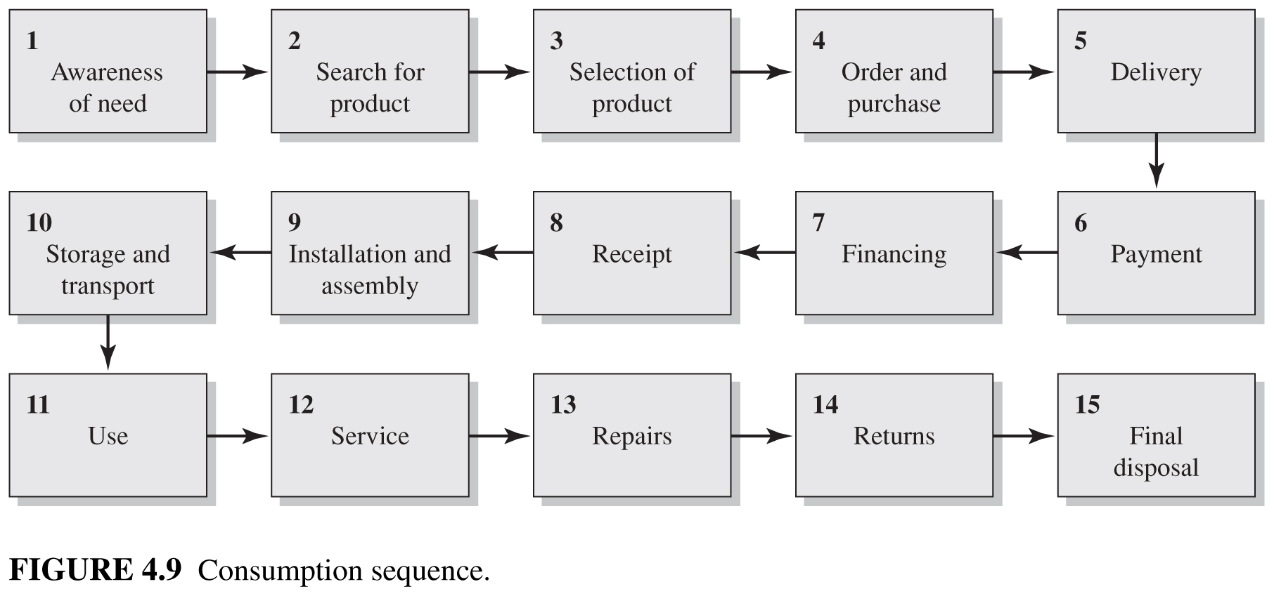
The consumption sequence.
An opportunity for differentiation exists anywhere in the consumption sequence.

Slide 58
key concepts
The definition of a market.
The value proposition.
The product, substitutes and complementors.
Differentiation.
Barriers to entry and exit.
Buyers and heavy users.

Slide 59
Barriers to entry are factors that make it costly for companies to enter an industry.

Slide 60
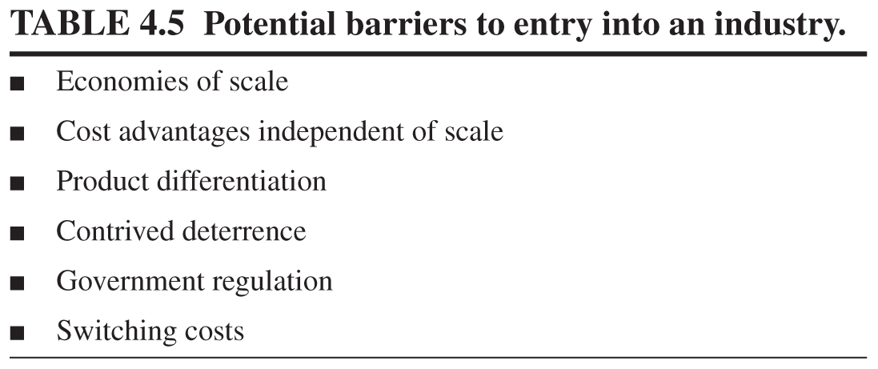

Slide 61
Product differentiation means brand identification and customer loyalty stemming from past advertising, customer service, product differences or simply being first.

Slide 62
Contrived deterrence occurs when firms throw up barriers at a cost to themselves.
Examples: Using lower prices, newer products or brand building to send a signal to potential entrants that intense responses will result if they try to enter.

Slide 63
Government can limit or foreclose entry with licensing requirements, limits on access to raw materials (e.g., zoning), air and water pollution standards, product safety and other requirements.

Slide 64
Switching costs are the costs to the customer to switch to a competitor.
Example: Switching from Windows to Mac OSX.

Slide 65
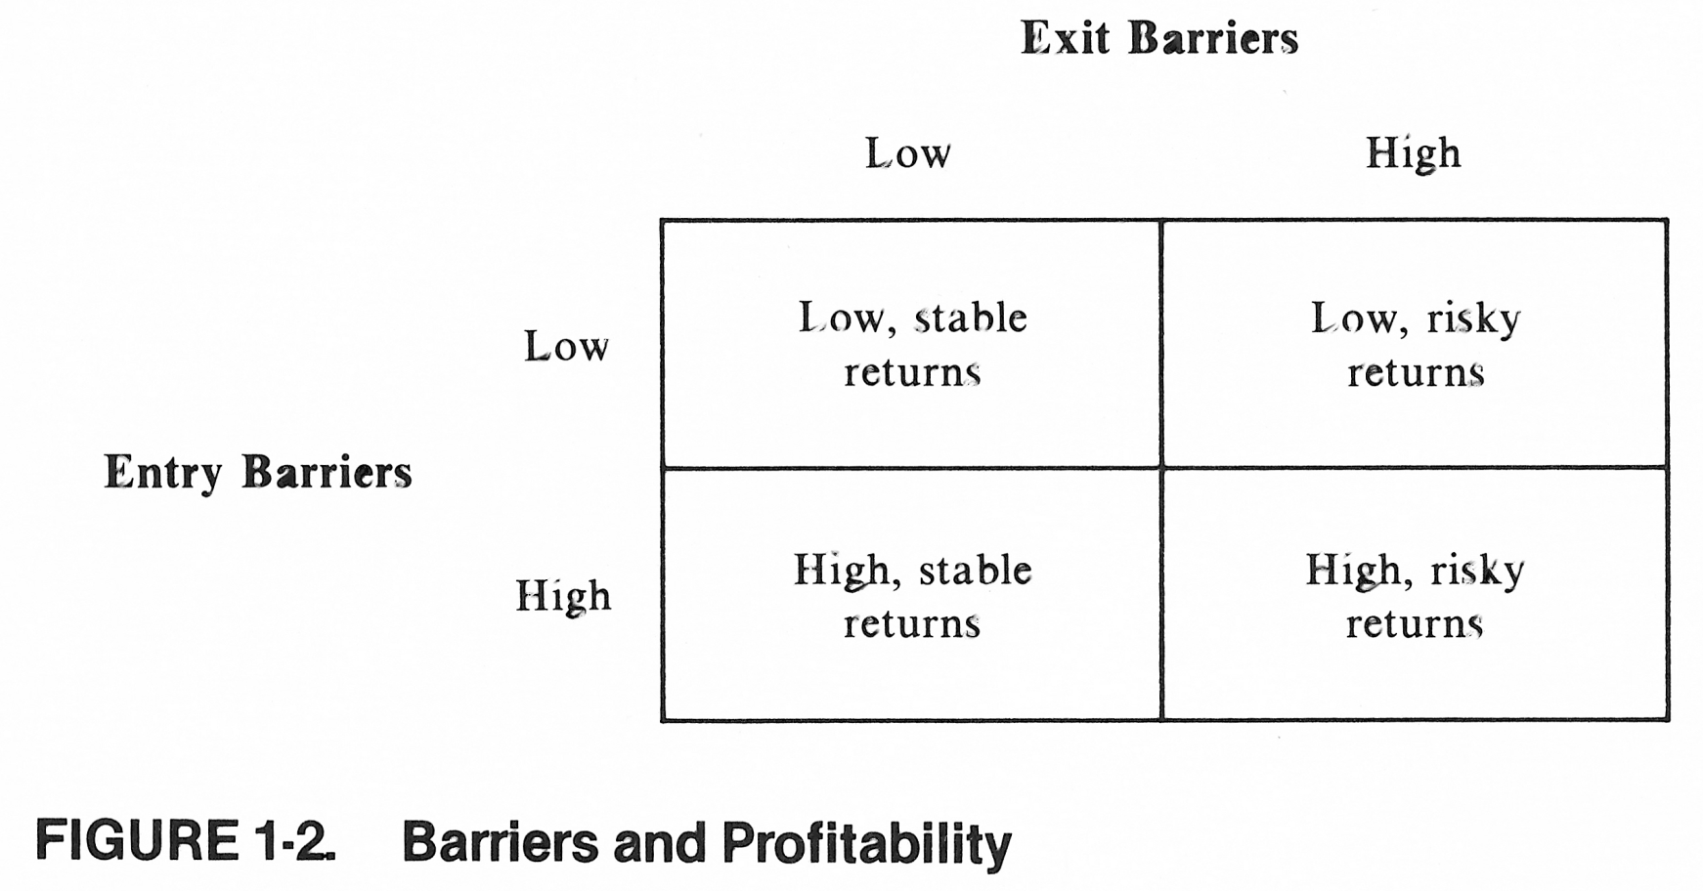
There can also be barriers to exit.
Source: Porter, Competitive Strategy, p. 22.

Slide 66
key concepts
The definition of a market.
The value proposition.
The product, substitutes and complementors.
Differentiation.
Barriers to entry and exit.
Buyers and heavy users.

Slide 67
Factors increasing the bargaining power of buyers
Large purchases relative to seller sales.
Purchases are a significant part of the buyer’s costs.
Product is standard or a commodity.
Low switching costs.
Buyer earns low profits.
Credible threat of backward integration.
Product is unimportant to the quality of the buyer’s products or services.
Buyer has full information.
Source: Porter, Competitive Strategy, pp. 24 – 26.

Slide 68
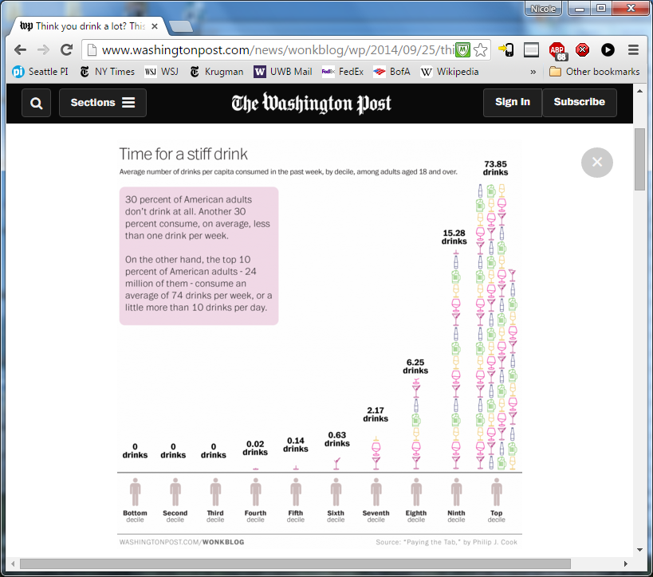
http://www.washingtonpost.com/news/wonkblog/wp/2014/09/25/think-you-drink-a-lot-this-chart-will-tell-you/

Slide 69
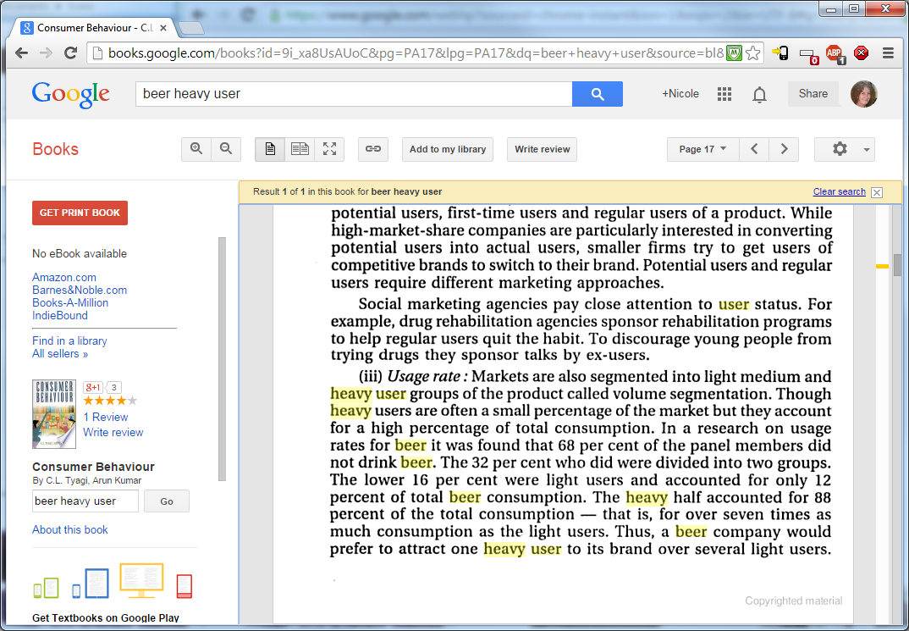
Beer consumers
Source: Tyagi, Kumar, Consumer Behavior, pp. 17-18. [link]

Slide 70
